Slide 1
Vue in SharePoint
Ben Hoffmann
EY

Slide 2
These slides and code
github.com/BenRunInBay/Vue-in-SP

Slide 3
Technologies referenced
Javascript
Vue (+ vue-cli, vue-router, vuex, vuetify)
SharePoint
REST APIs, OData
Promises
Markdown

Slide 4
SharePoint: Enterprise Content Mngmt
Use for Intranet or Extranet
Security / access control
Storing content
Multiple development options

Slide 5
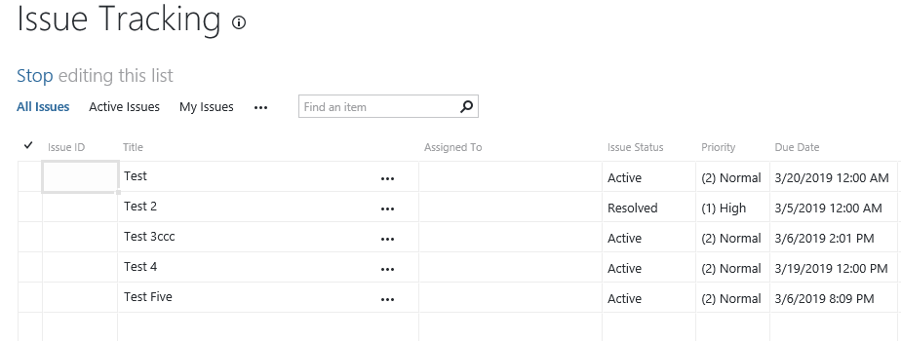
Storing content
Apps
Libraries
Lists

Slide 6
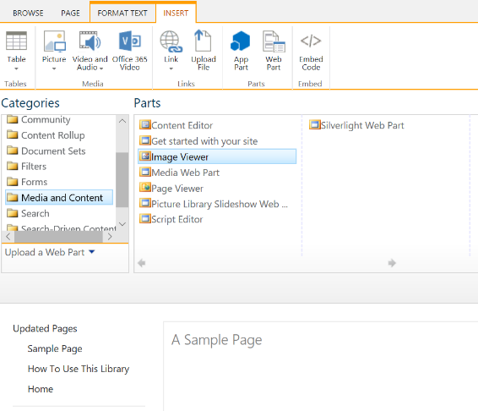
Building a web page in SharePoint
Masters
Pages
Webparts

Slide 7
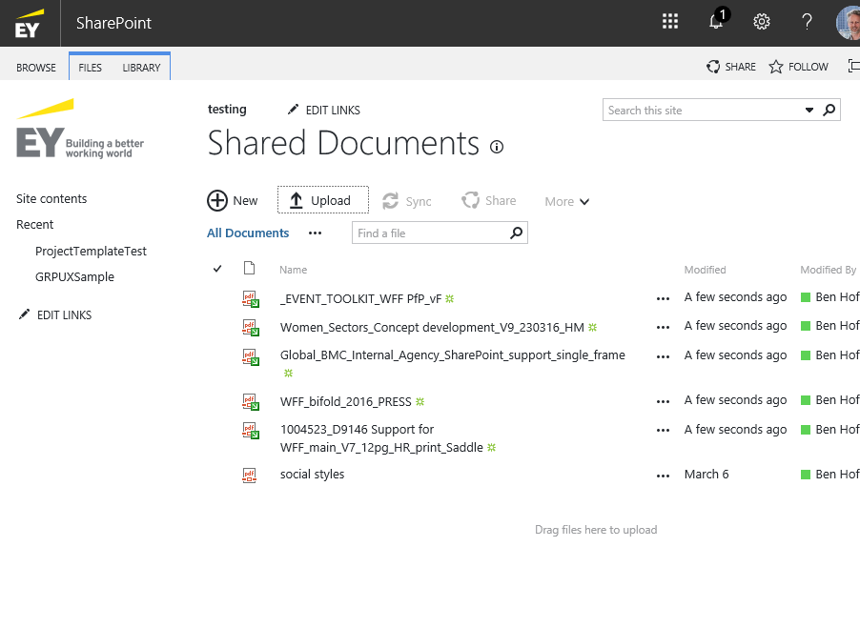
The standard UI
Improving it by:
Inserting images
Web parts
CSS overrides

Slide 8
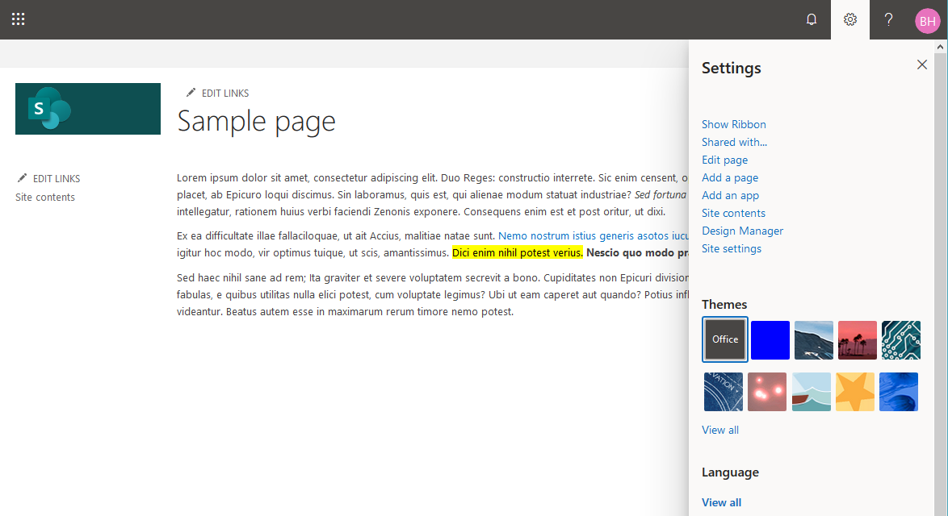
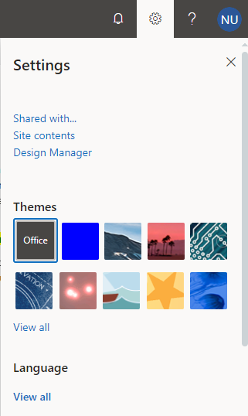
Editing interface
Or, read-only user:

Slide 9
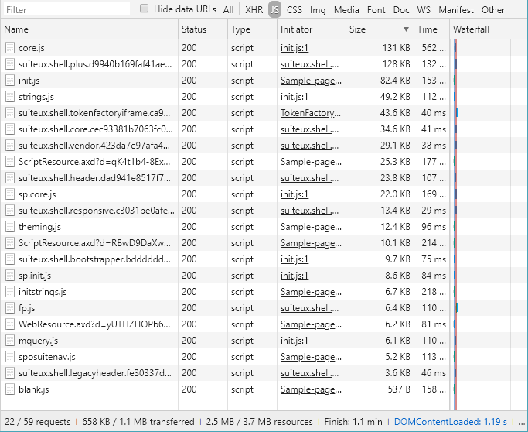
JS Payload of a SharePoint page

Slide 10
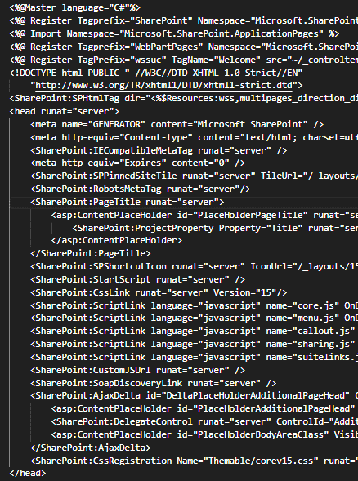
Example of a master

Slide 11
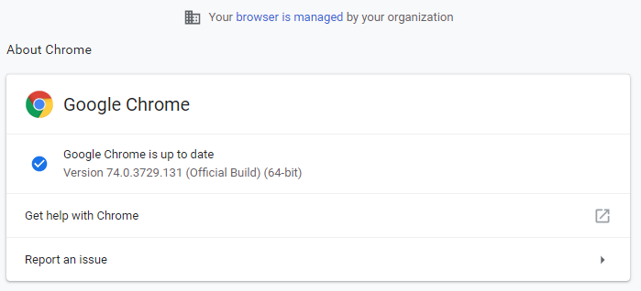
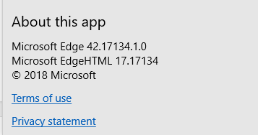
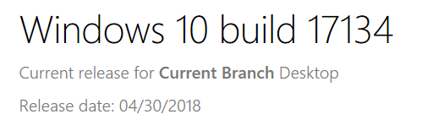
Latest browser technology?

Slide 12
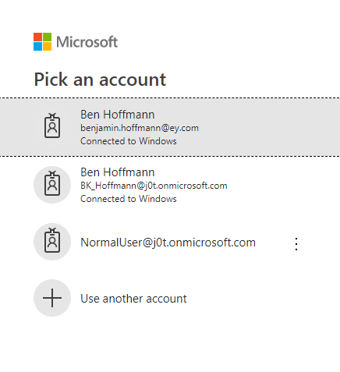
Authentication options

Slide 13
SharePoint is an ASP.net server

Slide 14
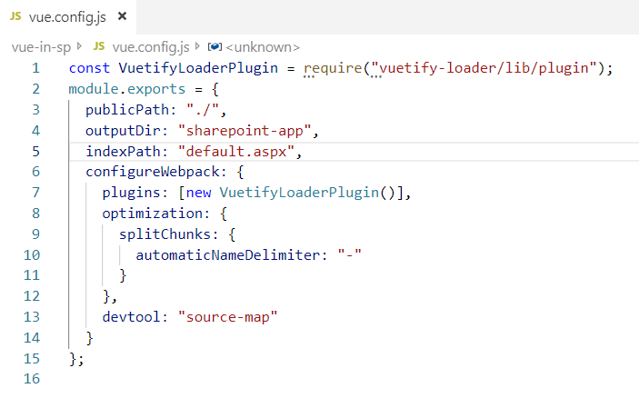
Vue-cli build
Output to default.aspx instead of index.html
Change delimiter used for multi-page apps

Slide 15
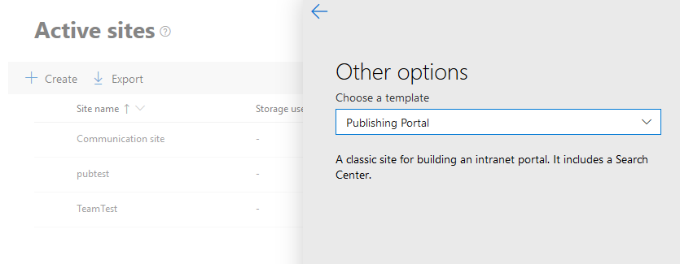
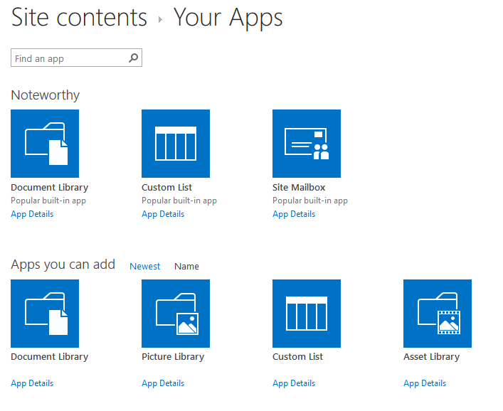
Creating your site and library
Choose a library that will display .aspx pages, not download them

Slide 16
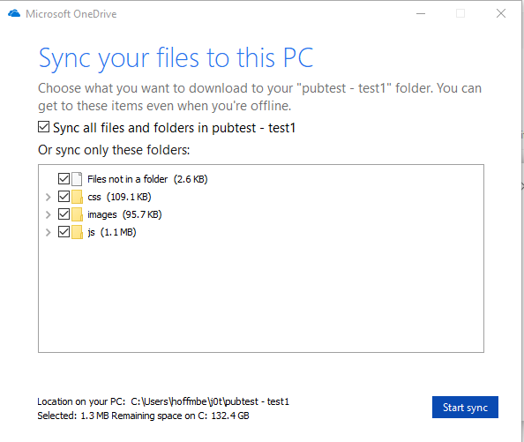
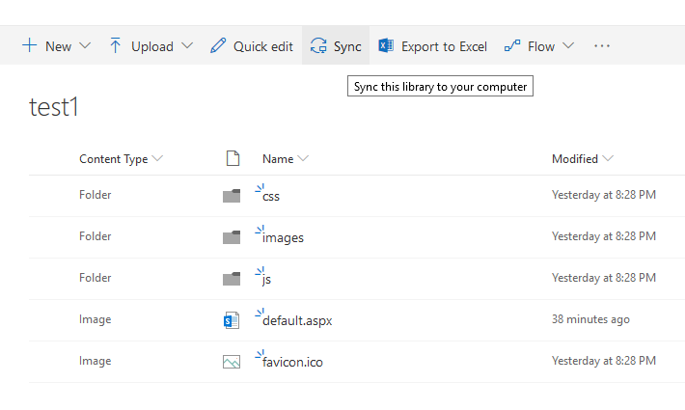
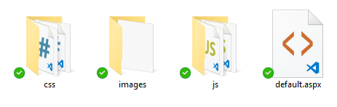
Upload to library, or use Sync
Notes:
[

Slide 17
SharePoint REST API
Read, write, update and delete
Work with Lists and Libraries
Access user information
Manage groups and access rights
Send email
…and more

Slide 18
Vue + SharePoint

Slide 19
In a nutshell
SharePoint lists and libraries (the data)
Developing an asynchronous, reactive web app
REST API
Vue-generated page(s)

Slide 20
Fundamental Strengths of SharePoint
Enterprise hosting
Security
Database-like features
User identification
Flexible development options

Slide 21
SharePoint as a “Headless CMS”

Slide 22
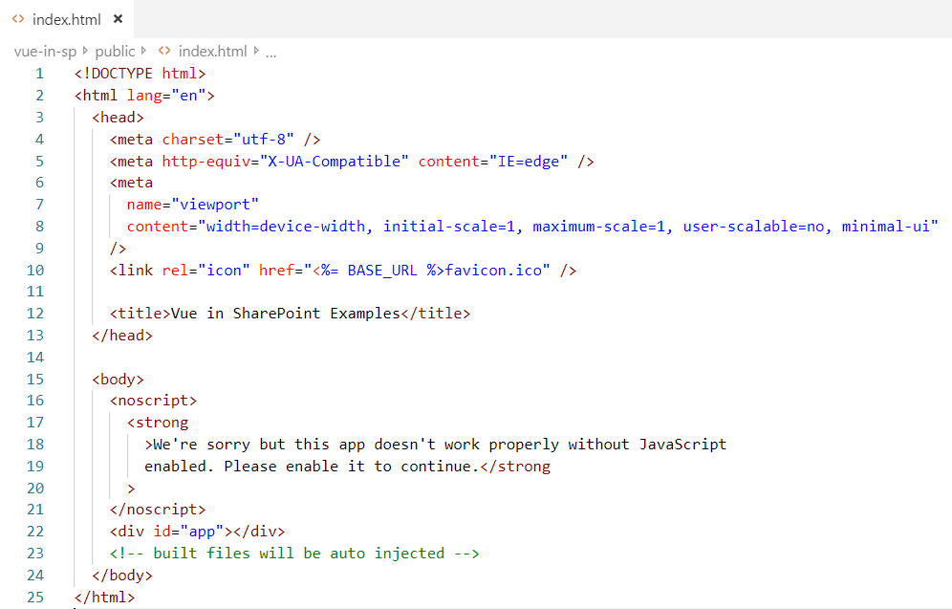
The Page (no Master)

Slide 23
Common REST API endpoints
/sites/MySite/
_api/contextinfo (for getting form digest)
_api/Web/Lists/getbytitle('list-name')/items
_api/sp.userprofiles.peoplemanager/getmyproperties
_api/sp.userprofiles.peoplemanager/GetPropertiesFor
_api/SP.Utilities.Utility.SendEmail

Slide 24
Build the end-user interface in Vue
Demo: Site Example

Slide 25
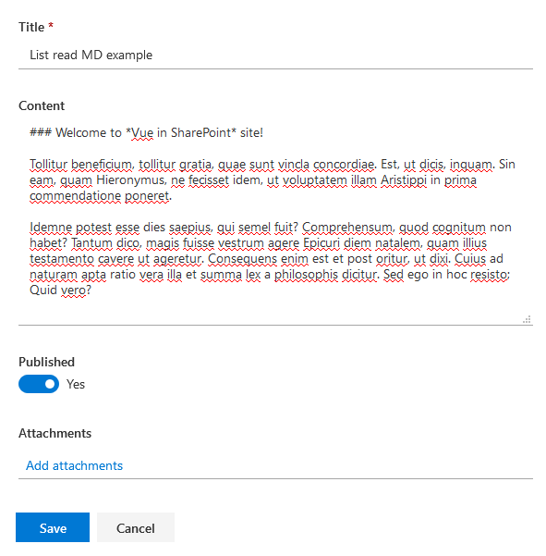
Manage content using SharePoint
Demo: List Read

Slide 26
Or build a custom UI for editing content
Consider:
Rich text vs. Plain text
Using Markdown format
Demo: Editor

Slide 27
Reading and writing to lists, libraries
Lists can have an attachment
Libraries of files have List-like metadata
Demo: Library Reader

Slide 28
Deferred data
"File": {
"__deferred": {
"uri": "https://.../_api/Web/Lists(guid'eadbcbc5-a3b2')/Items(187)/File"
}
}
Multiple asynchronous tasks with Promises
The Promises “roll up”
Demo: Deferred Read

Slide 29
Updating a list or library
Form digest
Versioning
{
"__metadata": {
"id": “2771ebb6-f530-4470-b824-4a4e30f5aa62",
"uri": "https://.../_api/Web/Lists(guid'eacecbc5-03b6')/Items(187)",
"etag": "135",
"type": "SP.Data.SampleListListItem"
},
"Title": "IBM partnered with the Mubadala Development Company",
"ID": 120
}
Demo: Update

Slide 30
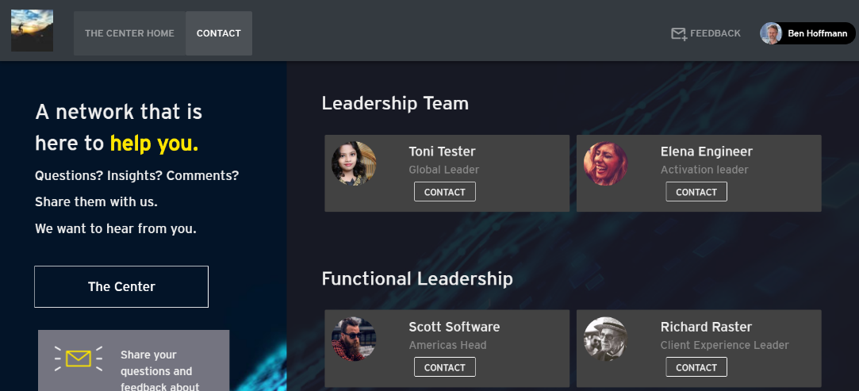
Get info about current or other users

Slide 31
Working with users in SharePoint
Look up using Active Directory Account Name: i:0#.f|membership|user@domain.com
ID of user is site-specific
Profile data is usually deferred
Render user profile reactively
Demo: User

Slide 32
Vuex store
A Vuex store is a great place to store information such as:
The current user
Commonly-accessed items from a list or library
Code: store/modules/user

Slide 33
Restricting access to portions of site
Use SharePoint permissions/sharing to determine which users can read or edit specific lists, libraries or files within a library
Store restricted content in the SharePoint app, not in the client-side web app
An inaccessible list returns nothing - no error is returned, just an empty response
Demo: Library document

Slide 34
Mobile responsiveness
Deactivate this Site Feature:

Slide 35
To explore further
SharePoint Framework for developing Webparts using frameworks such as Vue, React, etc.
PnPjs library for accessing SharePoint REST API
Building a Webpart using Vue

Slide 36
Bonus: precision edits to deployed files
Code: Hand-editing code

Slide 37
These slides and code
github.com/BenRunInBay/Vue-in-SP

